Slide 1
S.R.K.R ENGINEERING COLLEGE
DEPARTMENT OF ELECTRICAL AND ELECTRONICS ENGINEERING
A Dual-Switch Coupled Inductor-Based High StepUp DC-DC Converter
Under The Esteemed Guidance of:
Dr. G. Veeranna, M.Tech., Ph.D.
Assistant Professor, EEE Department
Presented by :
E. Bhargav (19B91A0220)
N. Bharath Raj (19B91A0219)
B. Sai Prasad (19B91A0212)
B. Sumanth Kumar (19B91A0215)
D. Karthikeya (19B91A0247)
D. Pavan Sai (19B91A0249)

Slide 2
INTRODUCTION
High-voltage gain is obtained by combining the coupled inductor (CI) and switched-capacitor (SC) voltage boosting techniques.
Combining CI and SC techniques, the design flexibility is increased, which leads to the adoption of low-voltage-rating semiconductor devices with low ON-state resistance resulting in low switching and conduction losses.
Unlike the conventional boost converter, thanks to the existence of leakage inductance, the output diode turns off naturally in the proposed converter, which suppresses the reverse-recovery problem and losses.

Slide 3
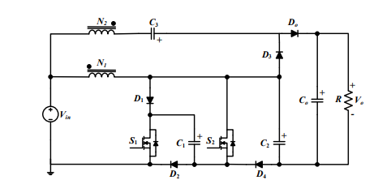
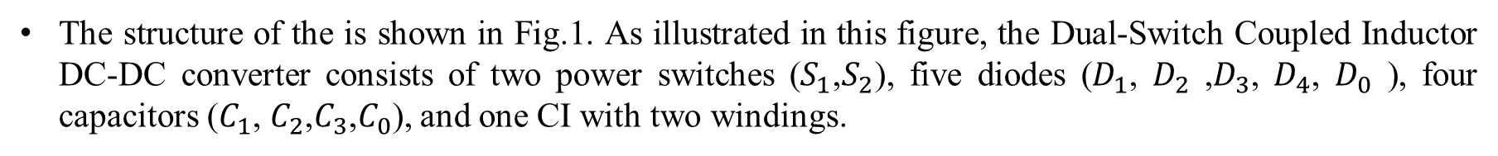
STRUCTURE OF PROPOSED CONVERTER
The structure of the is shown in Fig.1. As illustrated in this figure, the Dual-Switch Coupled Inductor DC-DC converter consists of two power switches ($S_{1}$,$S_{2}$), five diodes ($D_{1}$, $D_{2}$ ,$D_{3}$, $D_{4}$, $D_{0}$ ), four capacitors ($C_{1}$, $C_{2}$,$C_{3}$,$C_{0}$), and one CI with two windings.
The equivalent circuit of the proposed converter is demonstrated in which the two-winding CI is modeled with an ideal transformer with N1 and N2 as the number of turns in the primary and secondary sides, respectively.

Slide 4
OPERATION PRINCIPLE OF PROPOSED SYSTEM
The proposed converter is assumed to operate in continuous conduction mode (CCM).
All components are considered ideal without parasitic elements except the leakage inductances of the CI.
All the capacitors are assumed to be large enough to have a constant voltage over the switching period Ts.
The gate signals of the switches are applied simultaneously with a duty cycle less than 50 %.
The operation principle of the proposed converter is divided into four operation modes during one switching period.

Slide 5
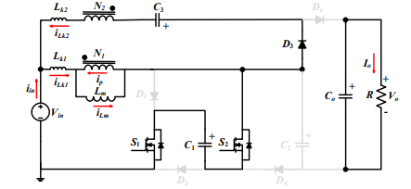
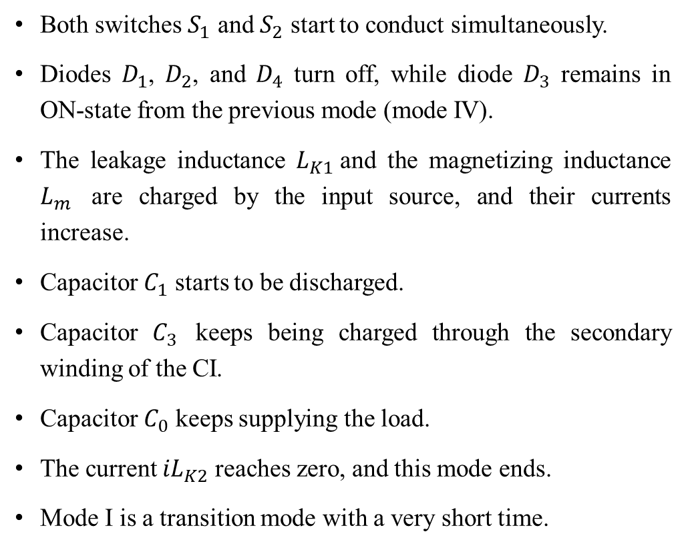
MODE-I
MODES OF OPERATION
Both switches $S_{1}$ and $S_{2}$ start to conduct simultaneously.
Diodes $D_{1}$, $D_{2}$, and $D_{4}$ turn off, while diode $D_{3}$ remains in ON-state from the previous mode (mode IV).
The leakage inductance $L_{K1}$and the magnetizing inductance $L_{m}$ are charged by the input source, and their currents increase.
Capacitor $C_{1}$ starts to be discharged.
Capacitor $C_{3}$ keeps being charged through the secondary winding of the CI.
Capacitor $C_{0}$ keeps supplying the load.
The current ${iL}_{K2}$ reaches zero, and this mode ends.
Mode I is a transition mode with a very short time.

Slide 6
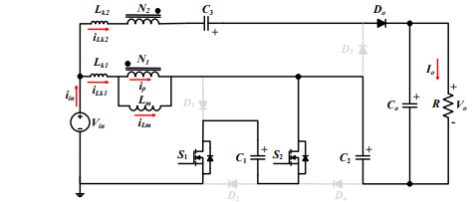
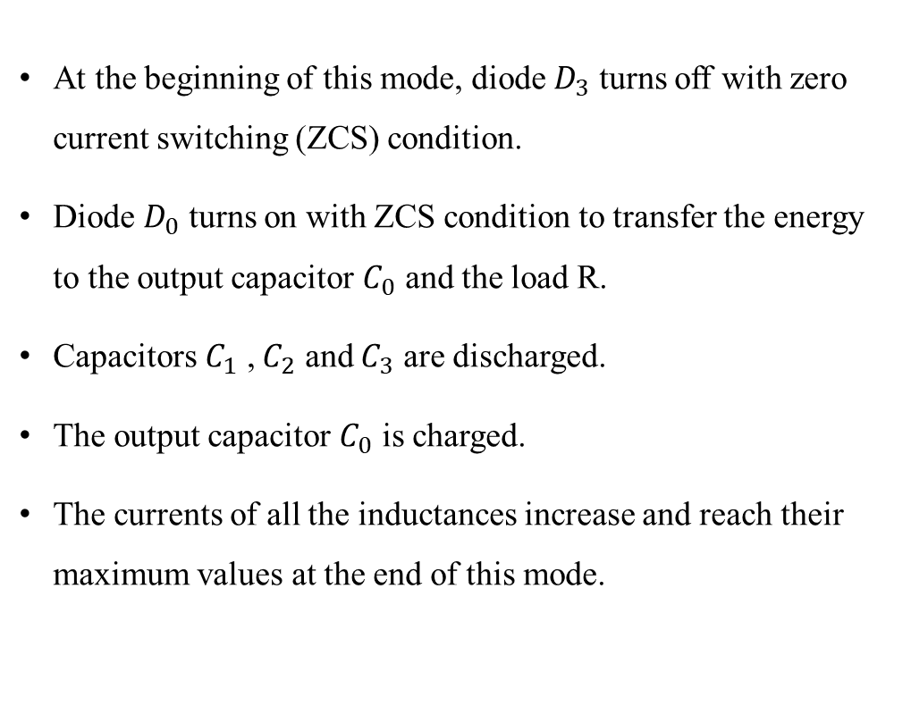
MODE-II
At the beginning of this mode, diode $D_{3}$ turns off with zero current switching (ZCS) condition.
Diode $D_{0}$ turns on with ZCS condition to transfer the energy to the output capacitor $C_{0}$ and the load R.
Capacitors $C_{1}$ , $C_{2}$ and $C_{3}$ are discharged.
The output capacitor $C_{0}$ is charged.
The currents of all the inductances increase and reach their maximum values at the end of this mode.

Slide 7
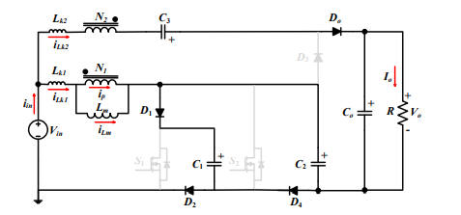
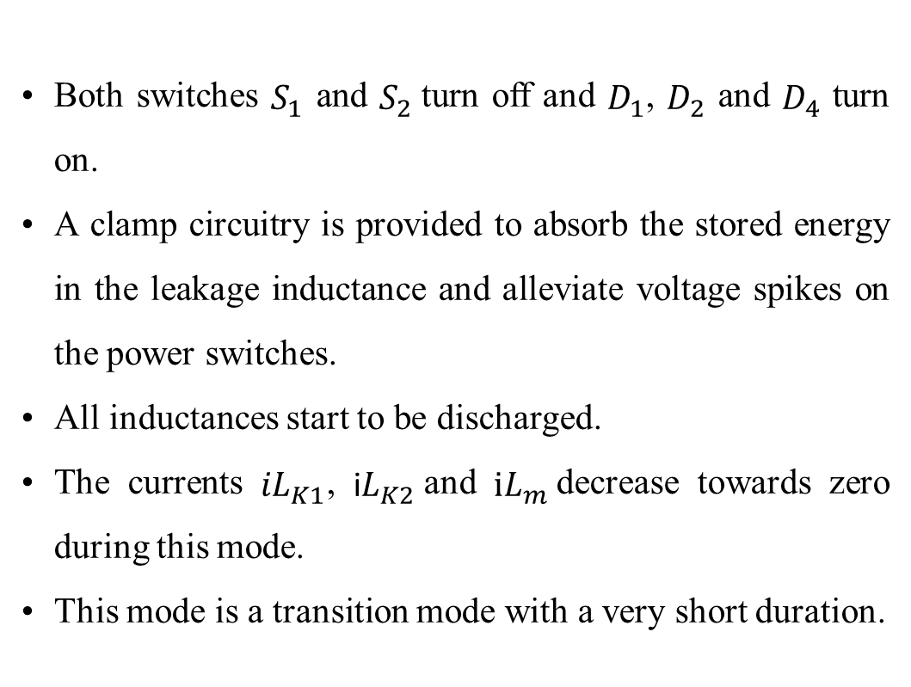
MODE-III
Both switches $S_{1}$ and $S_{2}$turn off and $D_{1}$, $D_{2}$ and $D_{4}$ turn on.
A clamp circuitry is provided to absorb the stored energy in the leakage inductance and alleviate voltage spikes on the power switches.
All inductances start to be discharged.
The currents ${iL}_{K1}$, i$L_{K2}$and $iL_{m}$decrease towards zero during this mode.
This mode is a transition mode with a very short duration.

Slide 8
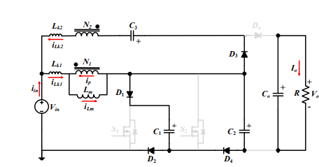
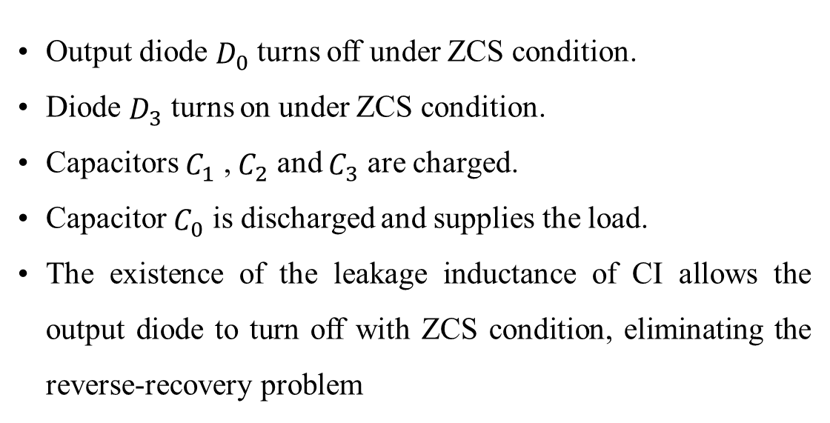
MODE-IV
Output diode $D_{0}$ turns off under ZCS condition.
Diode $D_{3}$ turns on under ZCS condition.
Capacitors $C_{1}$ , $C_{2}$ and $C_{3}$ are charged.
Capacitor $C_{0}$ is discharged and supplies the load.
The existence of the leakage inductance of CI allows the output diode to turn off with ZCS condition, eliminating the reverse-recovery problem

Slide 9
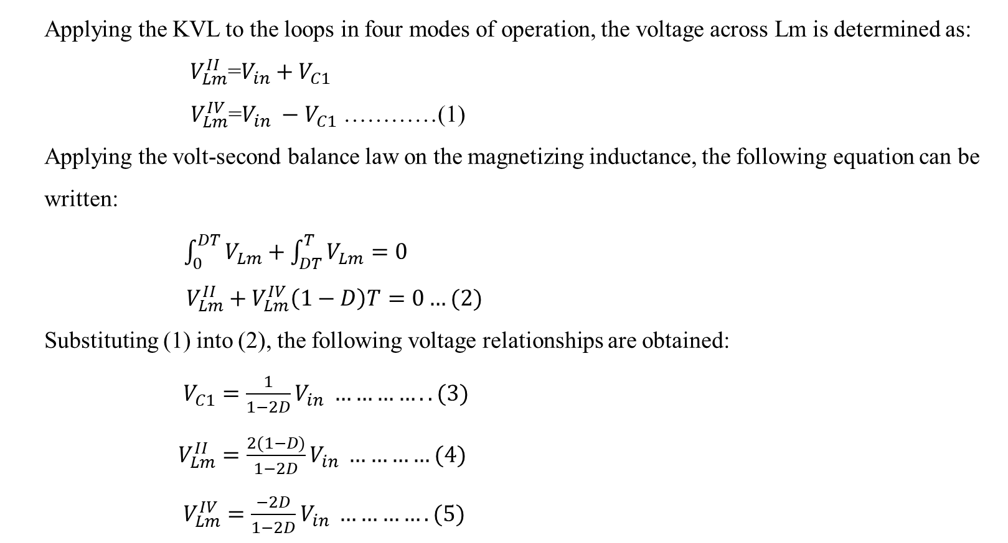
OUTPUT EQUATION OF THE PROPOSED CONVERTER
Applying the KVL to the loops in four modes of operation, the voltage across Lm is determined as:
$V_{Lm}^{II}$=$V_{in}+V_{C1}$
$V_{Lm}^{IV}$=$V_{in} −{ V}_{C1}$ …………(1)
Applying the volt-second balance law on the magnetizing inductance, the following equation can be written:
$\int_{0}^{DT}{V_{Lm}}+\int_{DT}^{T}{V_{Lm}}=0$
$V_{Lm}^{II}+V_{Lm}^{IV}\left(1−D\right)T=0…(2)$
Substituting (1) into (2), the following voltage relationships are obtained:
$V_{C1}=\frac{1}{1−2D}V_{in} …………..(3)$
$V_{Lm}^{II}=\frac{2(1−D)}{1−2D}V_{in} …………(4)$
$V_{Lm}^{IV}=\frac{−2D}{1−2D}V_{in} ………….(5)$

Slide 10
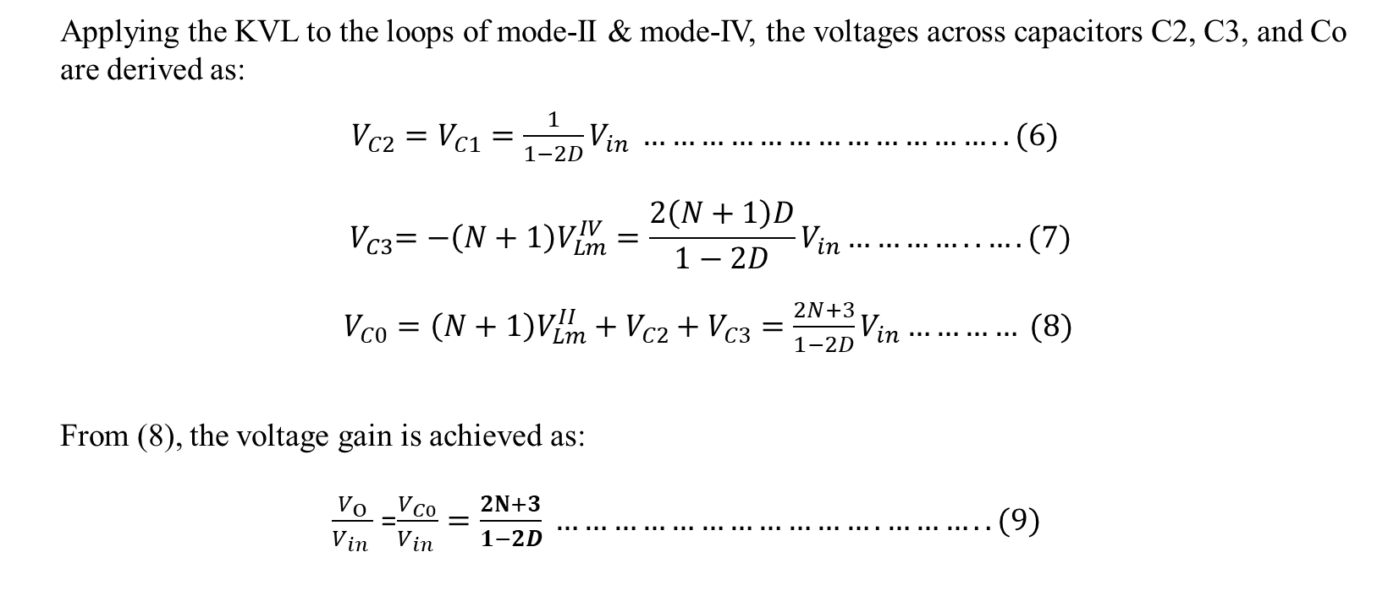
Applying the KVL to the loops of mode-II & mode-IV, the voltages across capacitors C2, C3, and Co are derived as:
$V_{C2}=V_{C1}=\frac{1}{1−2D}V_{in} ………………………………..(6)$
$${ V}_{C3}=−\left(N+1\right)V_{Lm}^{IV}=\frac{2\left(N+1\right)D}{1−2D}V_{in}…………..…. (7)$$
$V_{C0}=\left(N+1\right)V_{Lm}^{II}+V_{C2}+V_{C3}=\frac{2N+3}{1−2D}V_{in}………… (8)$
From (8), the voltage gain is achieved as:
$\frac{V_{O}}{V_{in} }$=$\frac{V_{C0}}{V_{in} }=\frac{2N+3}{1−2D} …………………………….………..(9)$

Slide 11
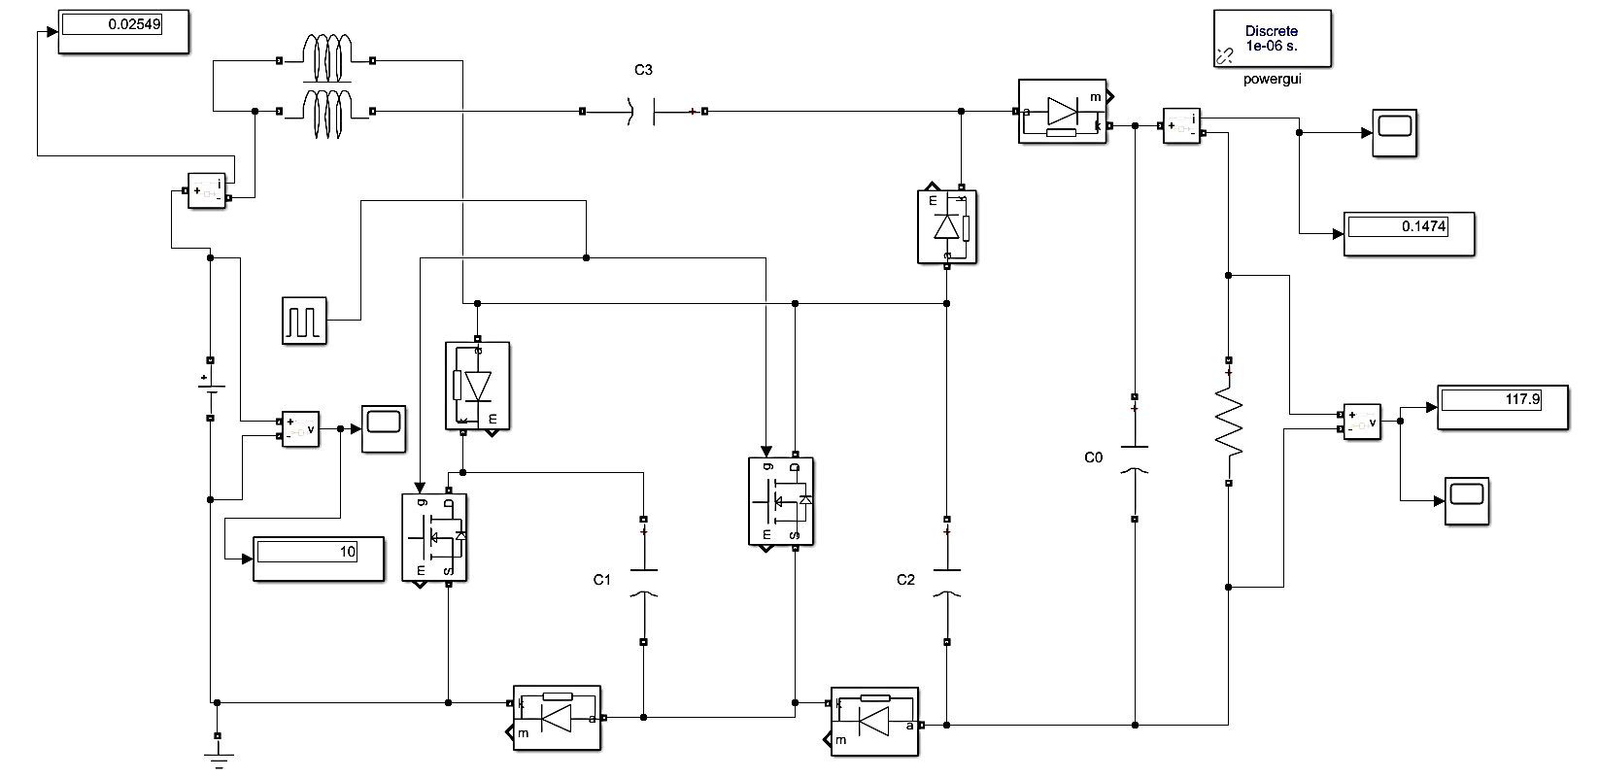
SOFTWARE IMPLEMENTATION
This module present the Simulink block diagram of Dual Switch Coupled Inductor High Step Up Dc-Dc Converter.
The simulation of Dual Switch Coupled Inductor High Step Up Dc-Dc Converter was carried out in MATLAB R2018a.

Slide 12
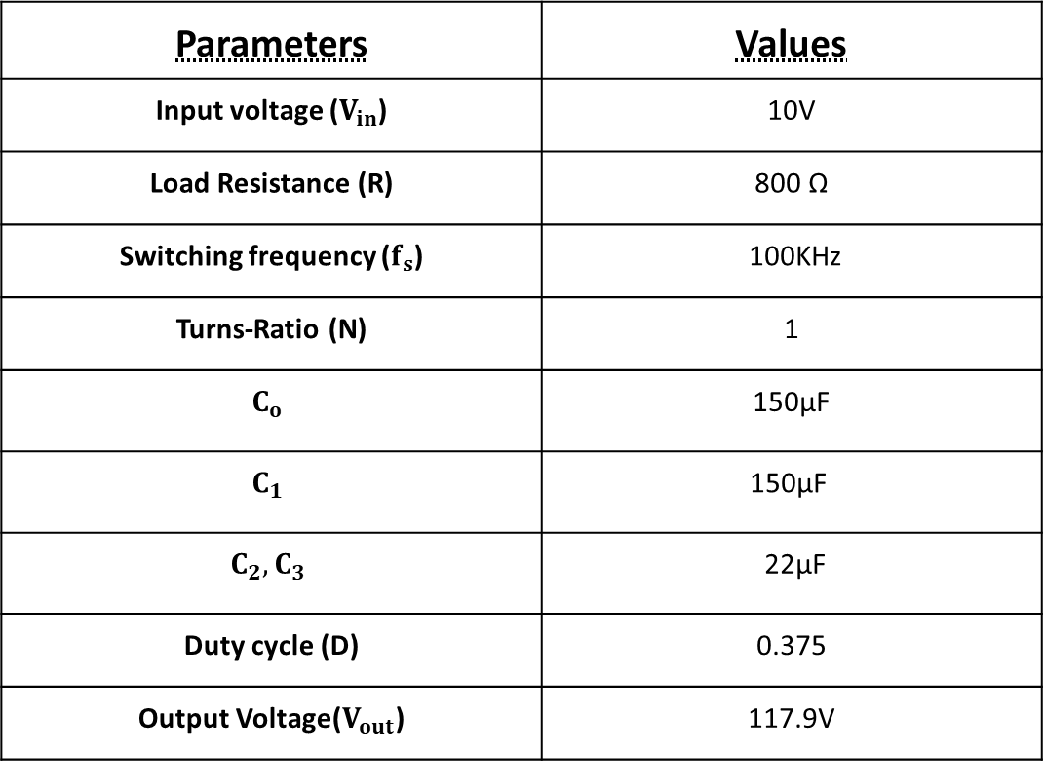
The parameters used for simulation are given Tabulation shown below.
Parameters | Values
Input voltage ($V_{in}$) | 10V
Load Resistance (R) | 800 Ω
Switching frequency ($f_{s}$) | 100KHz
Turns-Ratio (N) | 1
$$C_{o}$$ | 150µF
$$C_{1}$$ | 150µF
$$C_{2},C_{3}$$ | 22µF
Duty cycle (D) | 0.375
Output Voltage($V_{out}$) | 117.9V

Slide 13
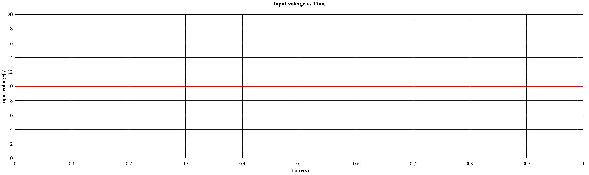
SIMULATION RESULT (PHASE-I)
INPUT VOLTAGE TO THE PROPOSED CONVERTER

Slide 14
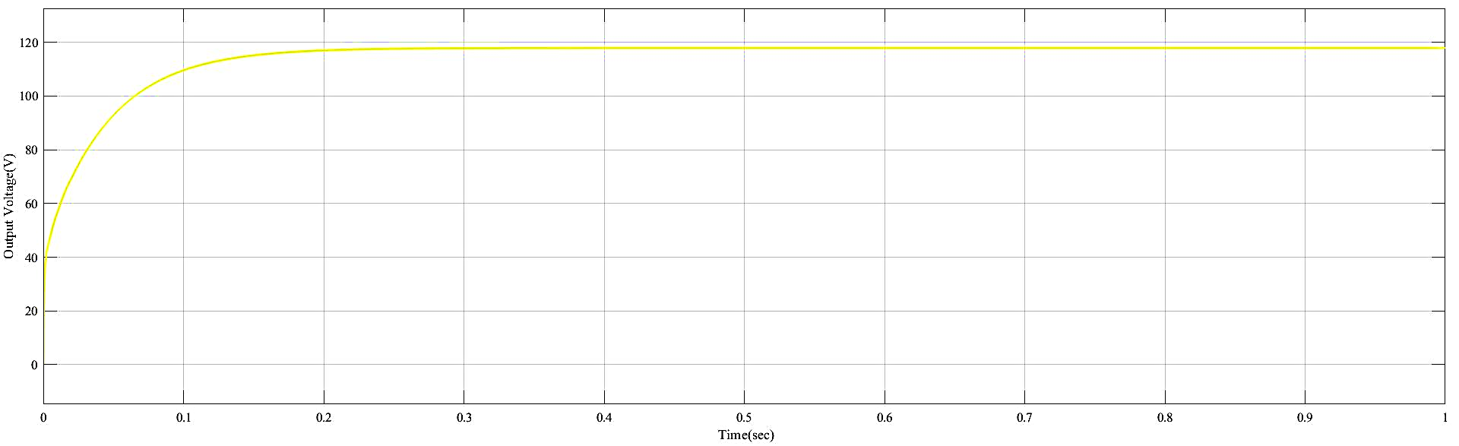
OUTPUT VOLTAGE TO THE PROPOSED CONVERTER

Slide 15
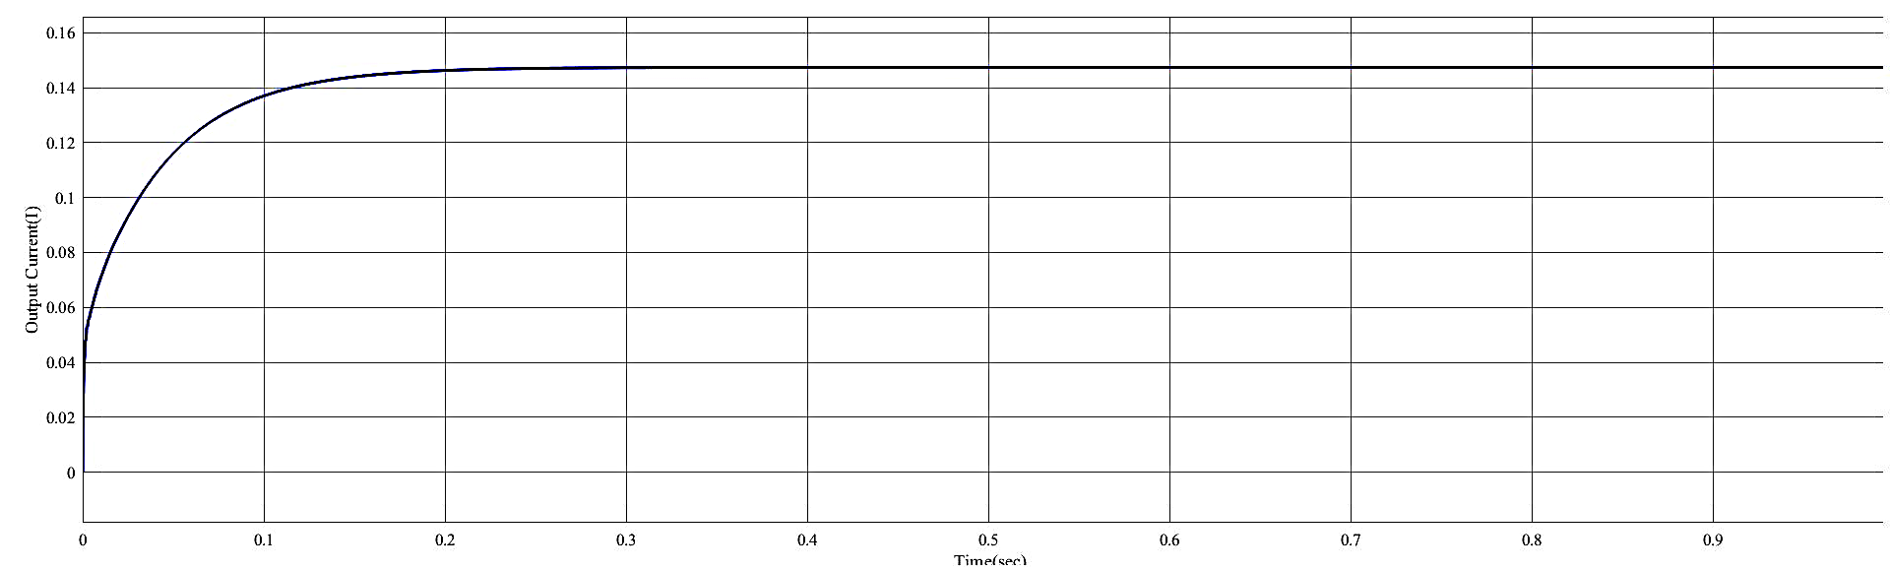
OUTPUT CURRENT TO THE PROPOSED COVERTER

Slide 16
SIMULATION CONCLUSION
The dual switch coupled inductor-based DC to DC converter has been successfully designed to convert an input voltage of 10V to an output voltage of 117.9V with a gain of 12%. The converter utilizes two switches, coupled inductors, and a capacitors to achieve high efficiency and low output ripple. The design process involved selecting appropriate components and ensuring the stability and performance of the converter through simulation. The converter has demonstrated excellent performance with high efficiency, low output ripple, and fast transient response.

Slide 17
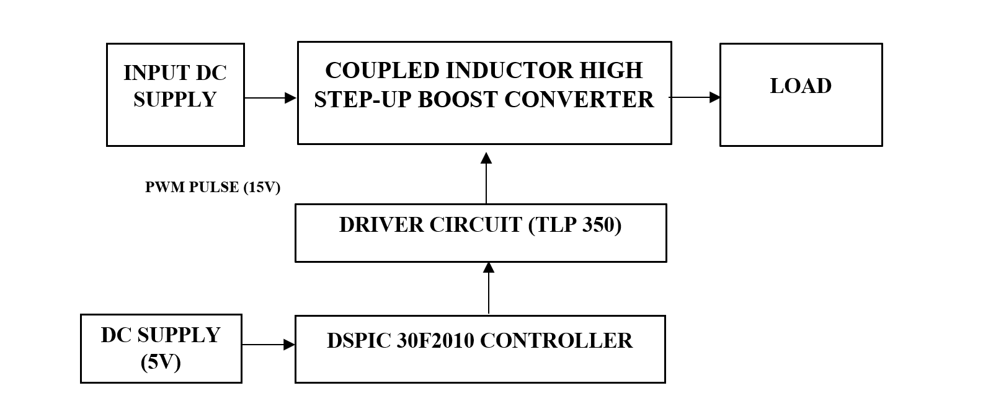
HARDWARE IMPLEMENTATION
AC TO DC
CONVERTER
BLOCK DIAGRAM OF THE PROPOSED CONVERTER

Slide 18
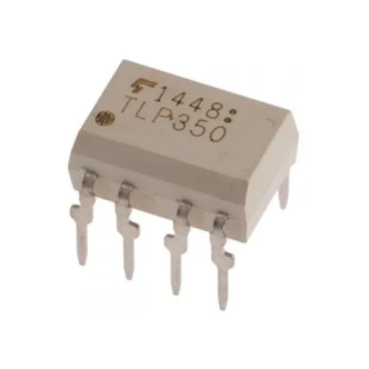
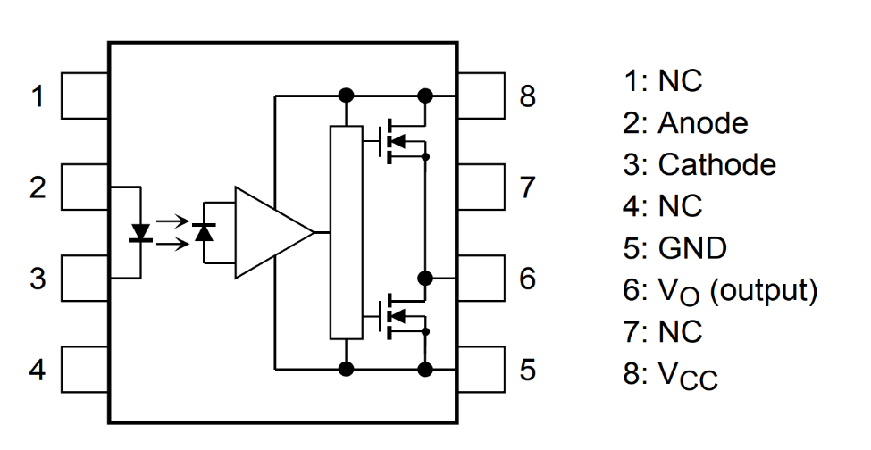
TLP350 GATE DRIVER
Gate driver circuit is circuit integral part of power electronics converters which is used to drive power semiconductor devices like BJT’s, IGBT’s and MOSFETs. Output of DC-DC converters mainly depend on behaviour of gate driver circuits.
The TLP350 is a high-speed isolated MOSFET driver that is capable of driving a wide range of power MOSFETs.
TLP350.
Pin diagram of TLP350.

Slide 19
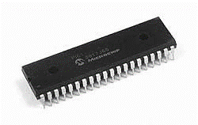
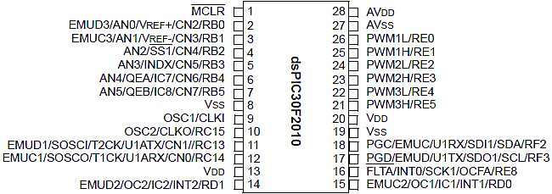
DSPIC30F2010 MICROCONTROLLER
The DSPIC family of Digital Signal Controllers features a fully- implemented digital signal processor (DSP) engine, 30 MIPS non-pipelined performance, C compiler friendly design, and a familiar Microcontroller architecture and design environment. The 20 new dsPIC30F2010 devices form three product families targeting motor control and power conversion, sensor, and general-purpose applications.
The initial 20-dsPIC30F2010devices feature 12 Kbytes to 144 Kbytes of on-chip secure Flash program memory space and up to 8 Kbytes of data space Operating voltage to Microcontroller applications at 5 volts.

Slide 20
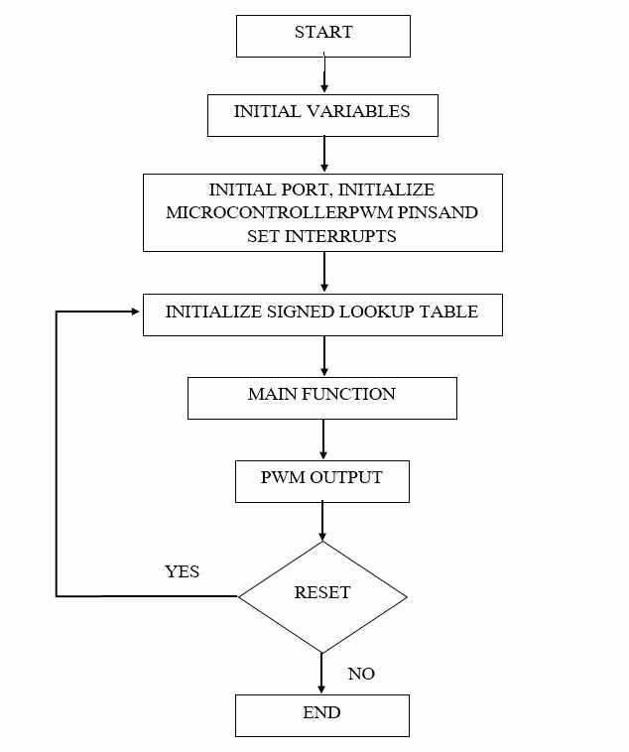
FLOW CHART OF THE MICROCONTROLLER PROGRAM

Slide 21
To dump a code into a microcontroller, we using PICKIT 2 software and Mikro C
Firstly, we need to connect the PICKIT 2 programmer to your computer and the microcontroller. Once the connections have been established, open the PICKIT 2 software and select the "Programmer-To-Go" option.
Next, select the appropriate microcontroller from the list and click on the "Read Device" button to verify that the connection has been established successfully.
Then, open the Mikro C software and compile the code that you want to upload to the microcontroller.
Finally, select the "Export HEX File" option and save the file to your computer. Back in the PICKIT 2 software, select the "Import Hex" option and locate the HEX file that you just saved.
Click on the "Program" button to upload the code to the microcontroller.
Once the process is complete, disconnect the PICKIT 2 programmer from the microcontroller and your code should now be running on the microcontroller.

Slide 22
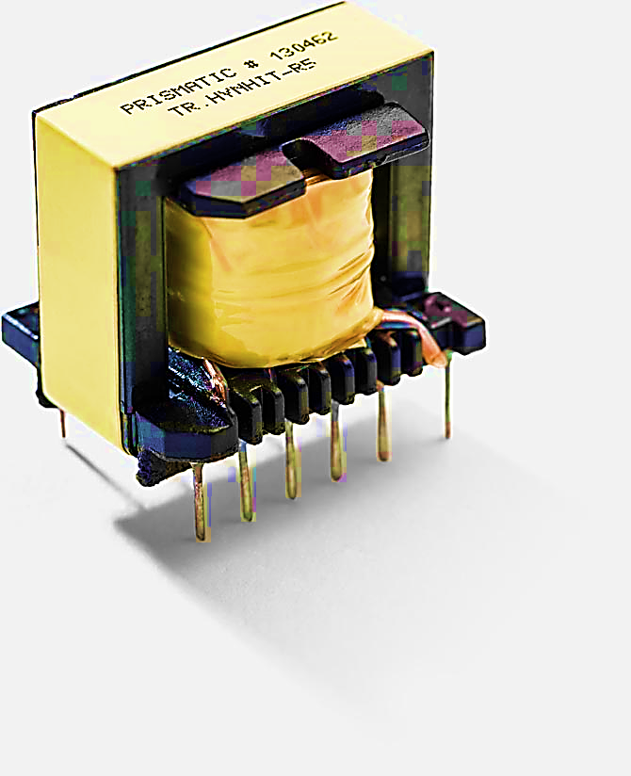
COUPLED INDUCTOR (EI 33 TRF)
coupled inductor is a type of electrical transformer that consists of two or more inductors that are magnetically coupled together. When an electrical current flows through the primary inductor, a magnetic field is created which induces a current in the secondary inductor.
Coupled inductors are commonly used in electronic circuits for a variety of purposes, including voltage regulation, noise reduction, and impedance matching. They are also used in power electronics applications such as DC-DC converters and inverters.
The EI33 specification refers to the size and shape of the transformer core. The core is made of laminated magnetic material and has a rectangular shape. The dimensions of the core are typically 33mm x 25mm, with a height of 13mm.

Slide 23
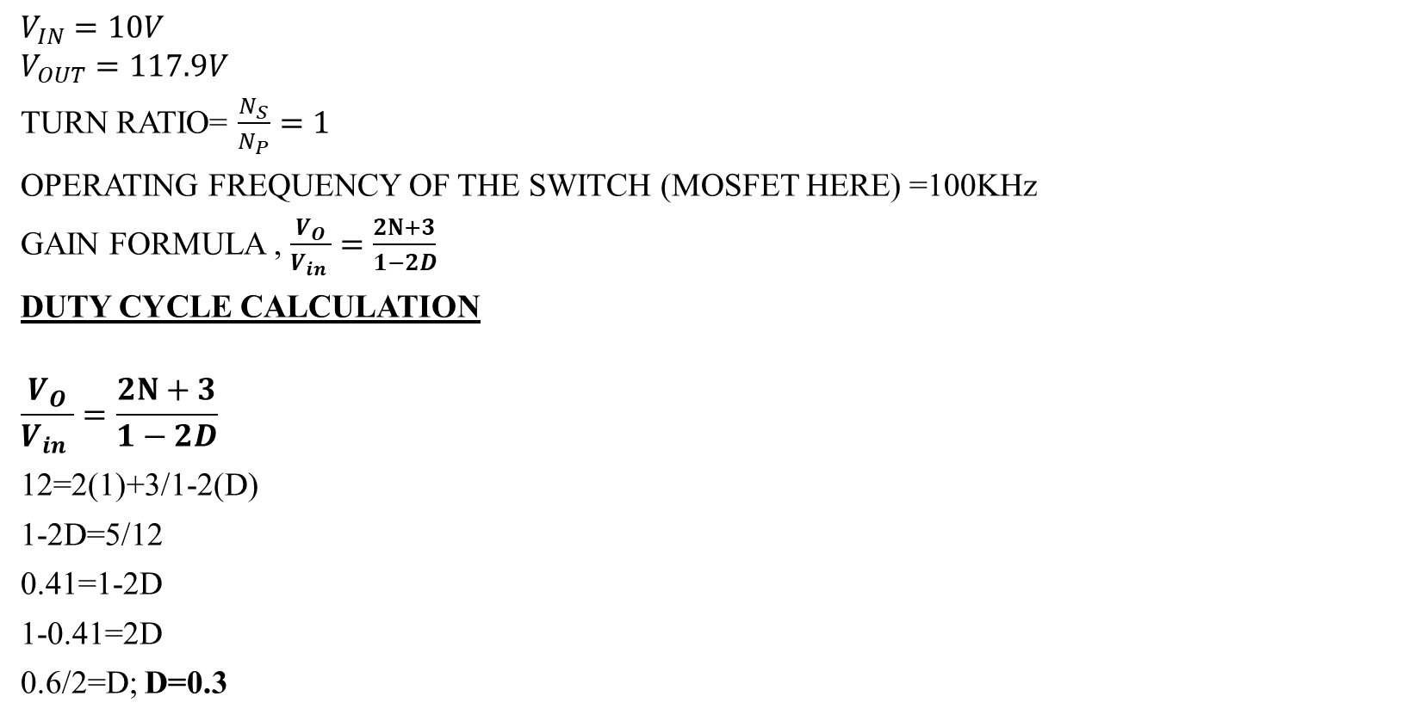
CALCULATION
$$V_{IN}=10V$$
$$V_{OUT}=117.9V$$
TURN RATIO= $\frac{N_{S}}{N_{P}}=1$
OPERATING FREQUENCY OF THE SWITCH (MOSFET HERE) =100KHz
GAIN FORMULA , $\frac{V_{O}}{V_{in} }=\frac{2N+3}{1−2D}$
DUTY CYCLE CALCULATION
$$\frac{V_{O}}{V_{in} }=\frac{2N+3}{1−2D}$$
12=2(1)+3/1-2(D)
1-2D=5/12
0.41=1-2D
1-0.41=2D
0.6/2=D; D=0.3
COUPLING COEFFICIENT CALCULATION
The coupling coefficient of coupled inductor, k = L_{m} / (L_{m} + L_{k})
L_{m} =200μH, L_{k} = 2μH
K = 200μH / (200μH + 2μH) = 0.9909
COUPLED INDUCTOR DESIGN
Here core used is EI 33.From the datasheet of EI 33 core
A_{L}=4 µ H
We have,
Mutual inductance = k √L_{P} * L_{S =} 200μH

Slide 24
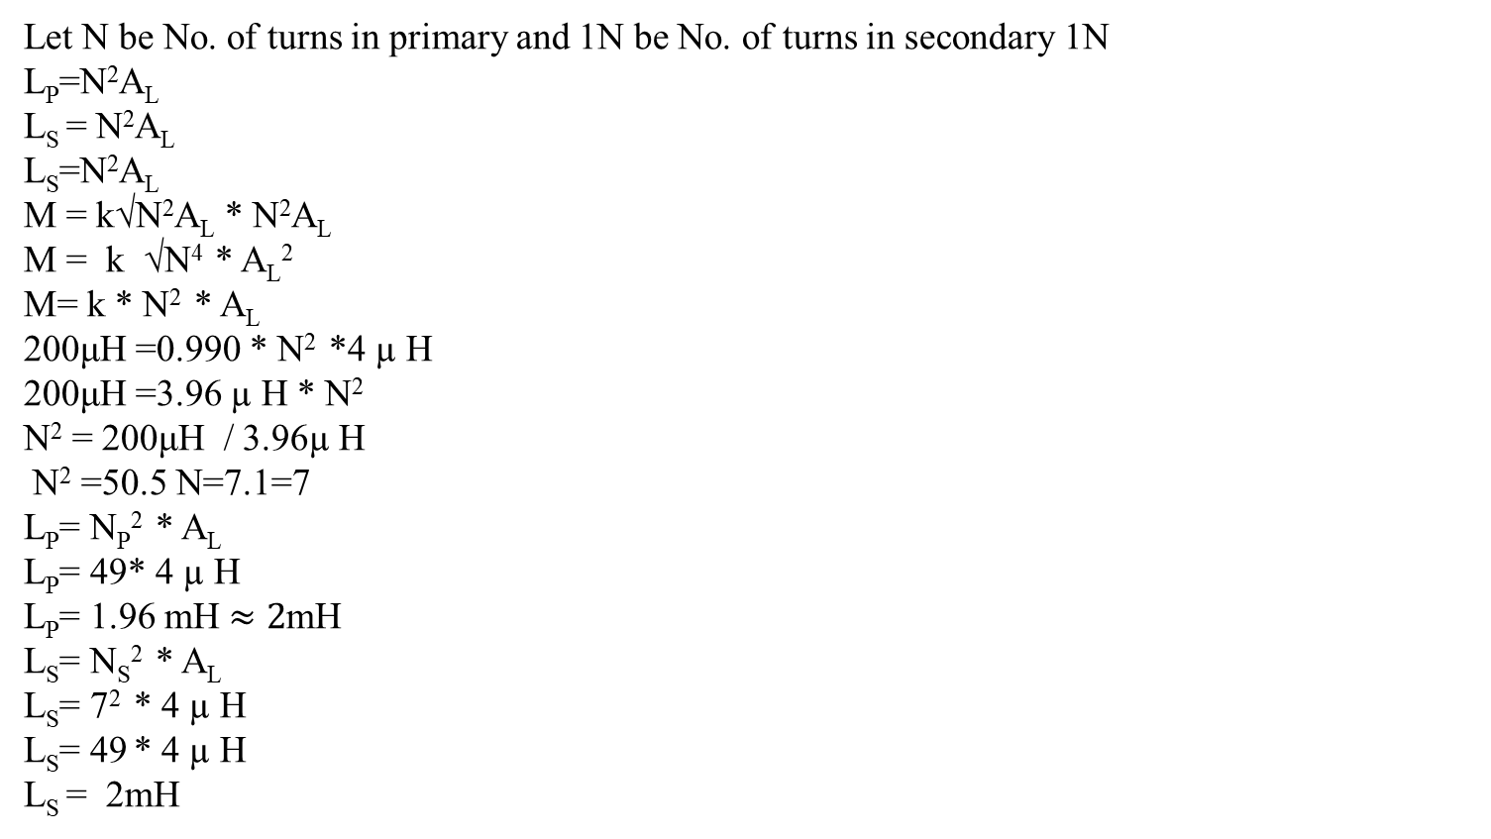
Let N be No. of turns in primary and 1N be No. of turns in secondary 1N
L_{P}=N²A_{L}
L_{S} = N²A_{L}
L_{S}=N²A_{L}
M = k√N²A_{L} * N²A_{L}
M = k √N⁴ * A_{L}²
M= k * N² * A_{L}
200μH =0.990 * N² *4 µ H
200μH =3.96 µ H * N²
N² = 200μH / 3.96µ H
N² =50.5 N=7.1=7
L_{P}= N_{P}² * A_{L}
L_{P}= 49* 4 µ H
L_{P}= 1.96 mH$≈2$mH
L_{S}= N_{S}² * A_{L}
L_{S}= 7² * 4 µ H
L_{S}= 49 * 4 µ H
L_{S} = 2mH

Slide 25
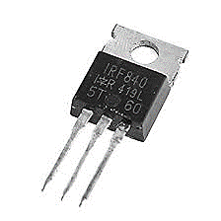
IRF840 (MOSFET)
It belongs to the N channel family of MOSFET.
The value of drain to source voltage used for breakdown is 500V.
The value of drain current for this MOSFET is 8A
The value of the gate threshold voltage is 10V.
The value of rise time is 23nS and the fall time is 20 Nano seconds.
The value of drain to source resistance is 0.85ohms.

Slide 26
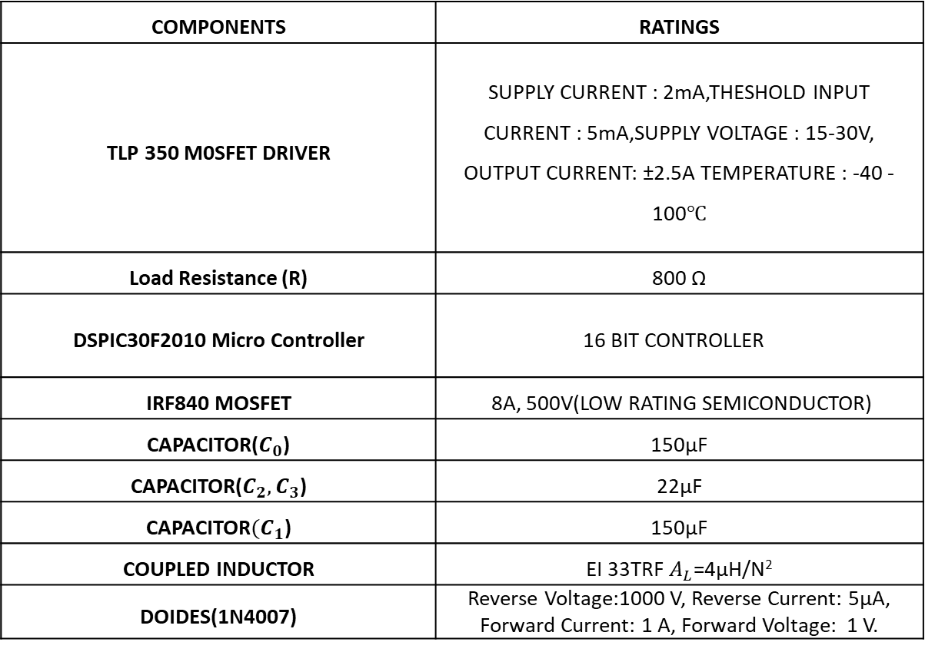
COMPONENTS AND ITS RATINGS
COMPONENTS | RATINGS
TLP 350 M0SFET DRIVER | SUPPLY CURRENT : 2mA,THESHOLD INPUT CURRENT : 5mA,SUPPLY VOLTAGE : 15-30V, OUTPUT CURRENT: ±2.5A TEMPERATURE : -40 -100$℃$
Load Resistance (R) | 800 Ω
DSPIC30F2010 Micro Controller | 16 BIT CONTROLLER
IRF840 MOSFET | 8A, 500V(LOW RATING SEMICONDUCTOR)
CAPACITOR($C_{0}$) | 150µF
CAPACITOR($C_{2},C_{3}$) | 22µF
CAPACITOR${(C}_{1}$) | 150µF
COUPLED INDUCTOR | EI 33TRF $A_{L}$=4µ$\text{H}\text{/}\text{N}\text{2}$
DOIDES(1N4007) | Reverse Voltage:1000 V, Reverse Current: 5µA, Forward Current: 1 A, Forward Voltage: 1 V.

Slide 27
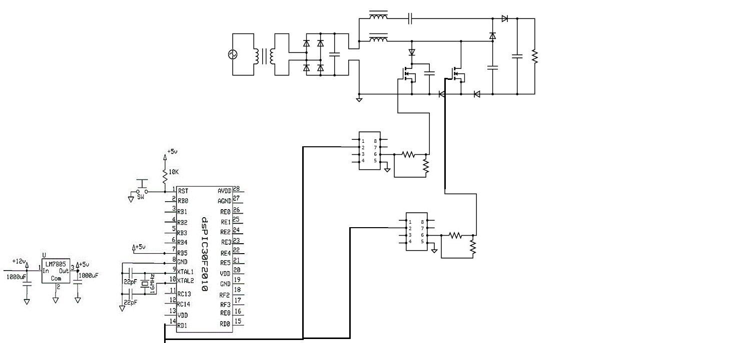
HARDWARE IMPLEMENTATION CIRCUIT DIAGRAM

Slide 28
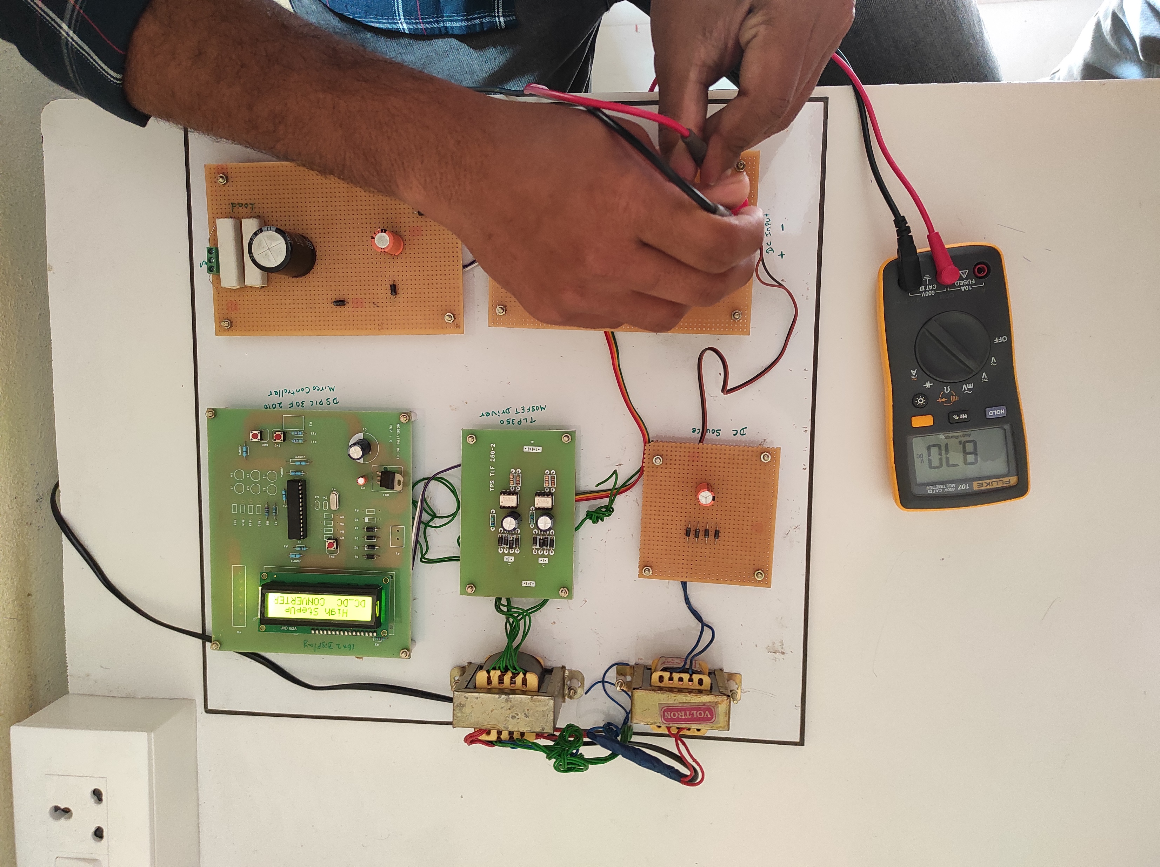
INPUT TO THE PROPOSED CONVERTER

Slide 29
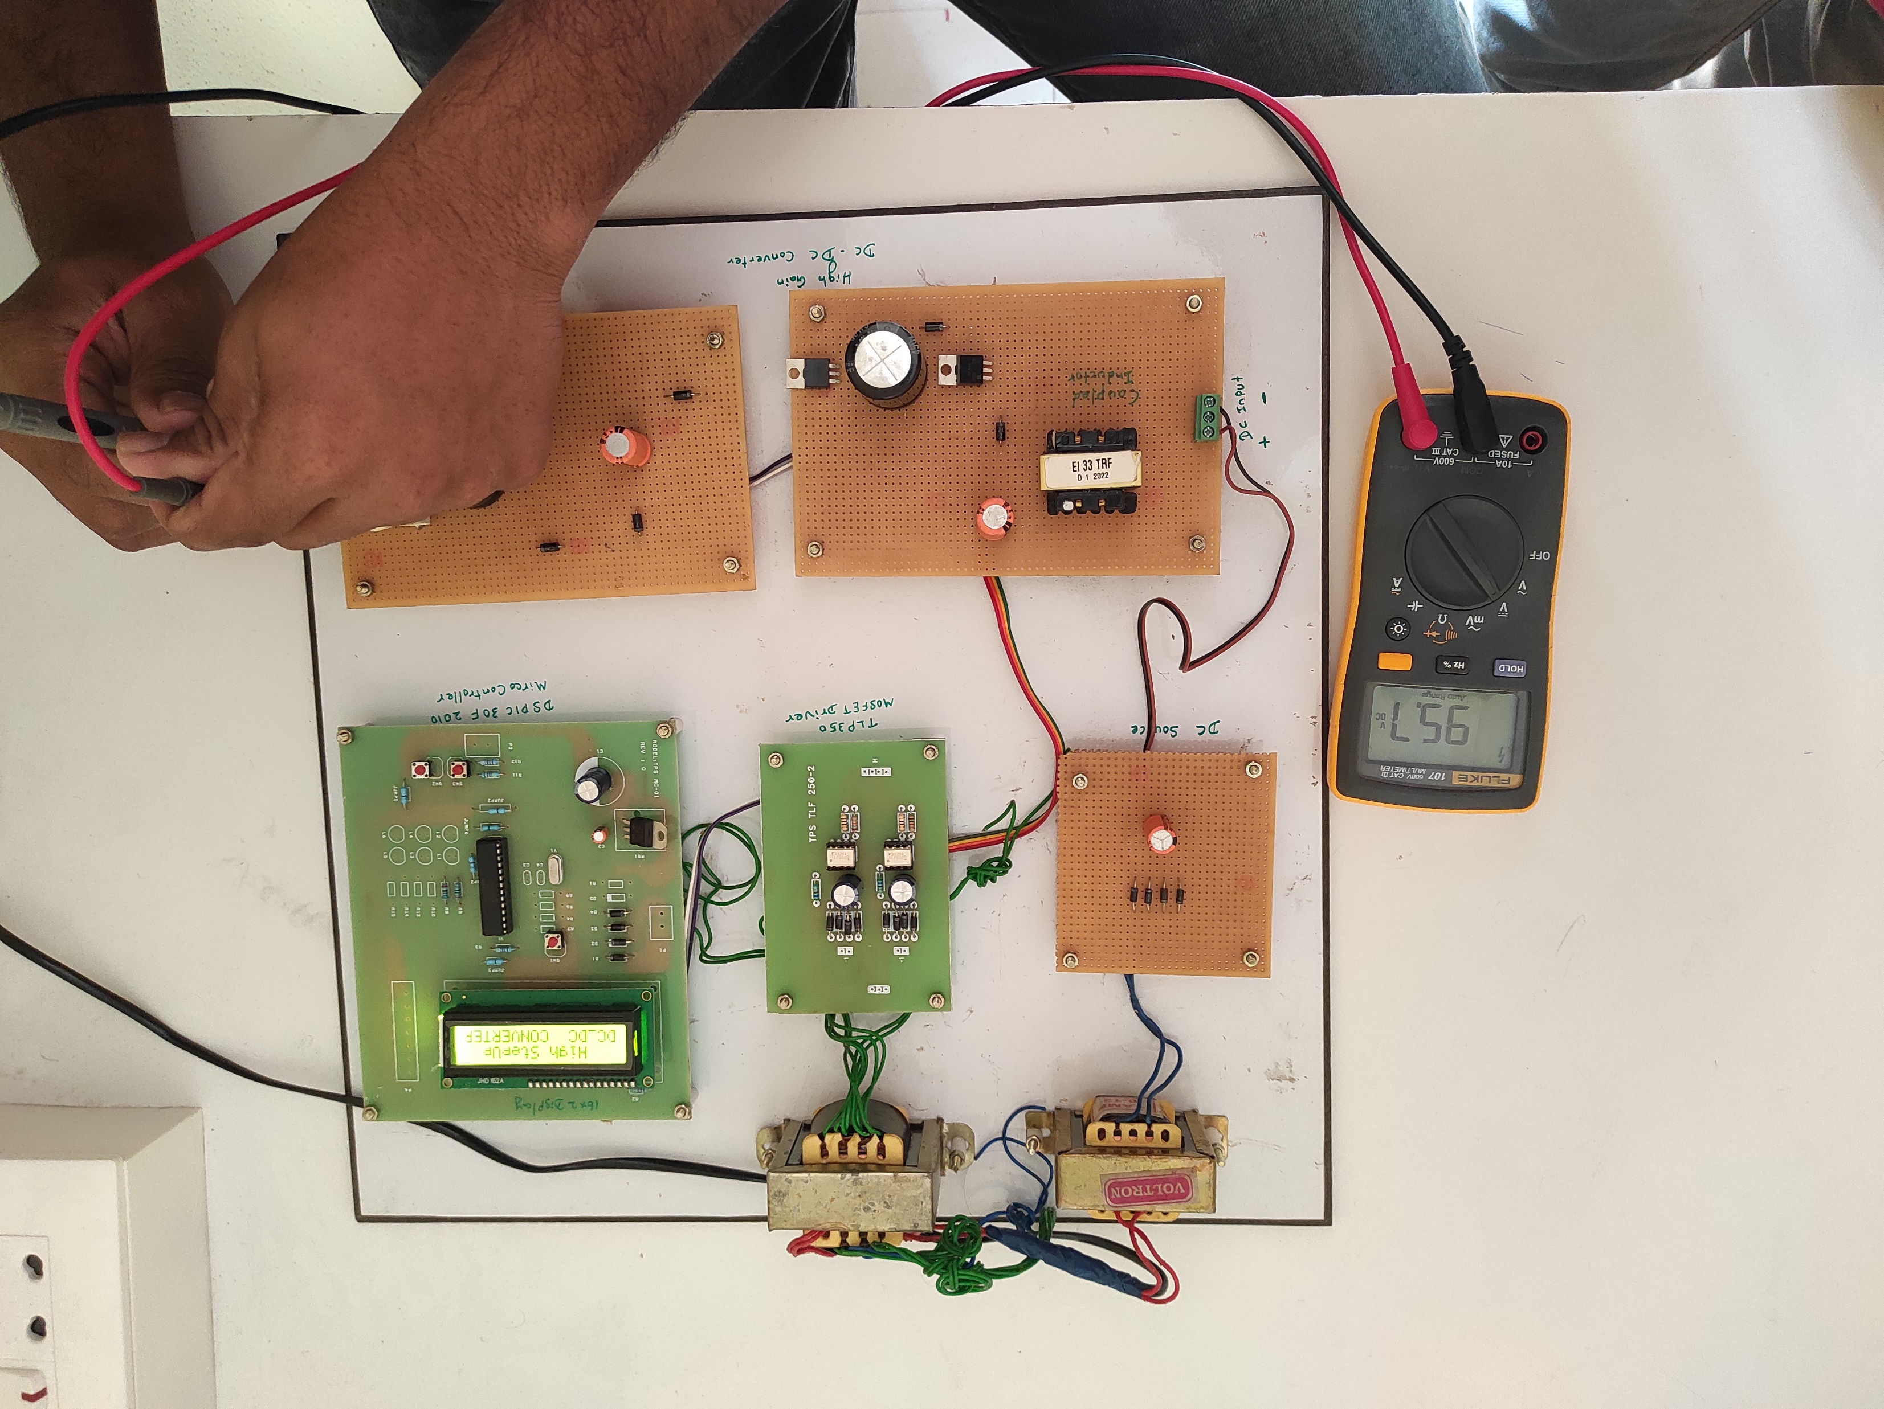
OUTPUT OF THE PROPOSED CONVERTER

Slide 30
HARDWARE CONCLUSION
The dual switch coupled inductor-based DC to DC converter has been successfully designed and implemented for hardware, with an input voltage of 8.7V and an output voltage of 95V, achieving a gain of 10.92%. The converter employs two switches, coupled inductors, and a capacitor to achieve high efficiency. The design process involved selecting appropriate components, PCB layout design, and testing of the converter circuit. The hardware implementation has demonstrated the effectiveness of the design, with excellent performance in terms of efficiency.

Slide 31
REFERENCE PAPER
[1] H. Liu, F. Li, and J. Ai, "A Novel High Step-Up Dual Switches Converter with Coupled Inductor and Voltage Multiplier Cell for a Renewable Energy System," IEEE Transactions on Power Electronics, vol. 31, pp. 4974-4983, 2016.
[2] B. Poorali, A. Torkan, and E. Adib, "High step-up Z-source DC–DC converter with coupled inductors and switched capacitor cell," IET Power Electronics, vol. 8, pp. 1394-1402, 2015.
[3] A. Samadian, S. H. Hosseini, M. Sabahi, and M. Maalandish, "A New Coupled Inductor Nonisolated High Step-Up Quasi Z-Source DC–DC Converter," IEEE Transactions on Industrial Electronics, vol. 67, pp. 5389-5397, 2020.

Slide 32
THANK YOU

